Slide 1

Web Programming
Lecture No.07

Slide 2
Canvas Tag
The <canvas> tag is used to draw graphics, on the fly, via scripting (usually JavaScript).
The <canvas> tag is transparent, and is only a container for graphics, you must use a script to actually draw the graphics.
Any text inside the <canvas> element will be displayed in browsers with JavaScript disabled and in browsers that do not support <canvas>.

Slide 3
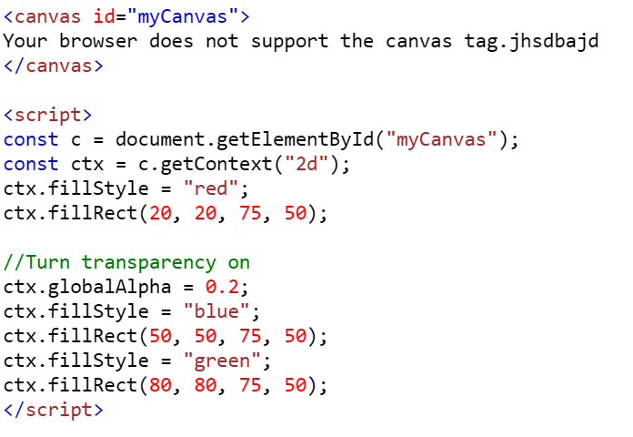
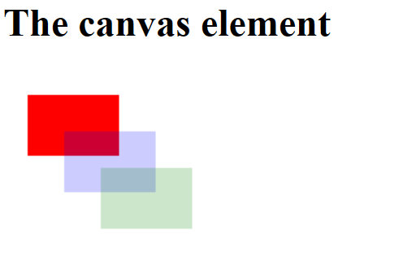
Example

Slide 4
Explain example
First line creates a <canvas> element with the ID "myCanvas"
script block retrieves the canvas element by its ID and gets its 2D drawing context, which is necessary for drawing shapes on the canvas.
The fill style is set to red.
A rectangle is drawn starting at the coordinates (20, 20) with a width of 75 pixels and a height of 50 pixels.
Global alpha (transparency) value to 0.2, meaning subsequent shapes drawn will be 20% opaque (80% transparent).

Slide 5
Audio Tag
The <audio> tag is used to embed sound content in a document, such as music or other audio streams.
The <audio> tag contains one or more <source> tags with different audio sources. The browser will choose the first source it supports.
The text between the <audio> and </audio> tags will only be displayed in browsers that do not support the <audio> element.
There are three supported audio formats in HTML: MP3, WAV, and OGG.

Slide 6
Attributes of Audio Tag
Attribute | Value | Description
autoplay | autoplay | Specifies that the audio will start playing as soon as it is ready
controls | controls | Specifies that audio controls should be displayed (such as a play/pause button etc)
loop | loop | Specifies that the audio will start over again, every time it is finished
muted | muted | Specifies that the audio output should be muted
src | URL | Specifies the URL of the audio file

Slide 7
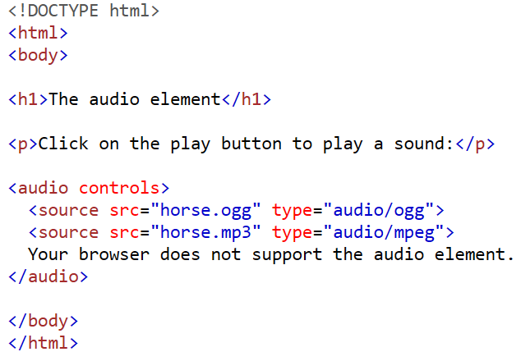
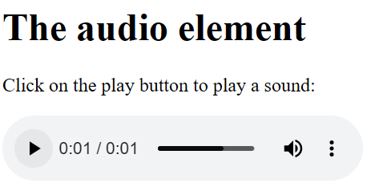
Example

Slide 8
Video Tag
The <video> tag is used to embed video content in a document, such as a movie clip or other video streams.
The <video> tag contains one or more <source> tags with different video sources. The browser will choose the first source it supports.
The text between the <video> and </video> tags will only be displayed in browsers that do not support the <video> element.
There are three supported video formats in HTML: MP4, WebM, and OGG.

Slide 9
Attributes of Video Tag
Attribute | Value | Description
autoplay | autoplay | Specifies that the video will start playing as soon as it is ready
controls | controls | Specifies that video controls should be displayed (such as a play/pause button etc).
height | pixels | Sets the height of the video player
loop | loop | Specifies that the video will start over again, every time it is finished
muted | muted | Specifies that the audio output of the video should be muted
poster | URL | Specifies an image to be shown while the video is downloading, or until the user hits the play button
src | URL | Specifies the URL of the video file
width | pixels | Sets the width of the video player

Slide 10

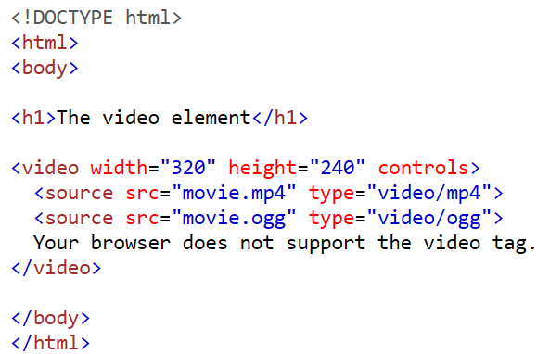
Example

Slide 11
HTML FORM TAG
HTML forms are used to pass data to a server. The <form> tag is used to create an HTML form for user input.
<form> tag is used to start a form
</form> tag is used to end a form
Between <form> and </form>, form elements are placed
We can declare a form as:
  <form attributes>
  form elements and layout tags
  </form>

Slide 12
The <form> element can contain one or more of the following form elements:
  <input>
  <textarea>
  <button>
  <select>
  <option>
  <fieldset>
  <label>
  <legend>

Slide 13
Attributes | Value | Description
action | URL | Specifies where to send the form-data when a form is submitted
method | get post | Specifies the HTTP method to use when sending form-data
name | Text | Specifies the name of a form
target | _blank _self | Specifies where to display the response that is received after submitting the form

Slide 14
The Input Element
The most important form element is the <input> element.
The <input> element is used to select user information.
An <input> element can vary in many ways, depending on the type attribute. An <input> element can be of type text field, checkbox, password, radio button, submit button, and more.

Slide 15
Common input types
Text Fields
Password Field
Radio Buttons
Checkboxes
Submit Button

Slide 16

Text Fields
<input type="text"> defines a one-line input field that a user can enter text into:
<form>
First name: <input type="text" name="firstname" /><br />
Last name: <input type="text" name="lastname" />
</form>
How the HTML code above looks in a browser:

Slide 17
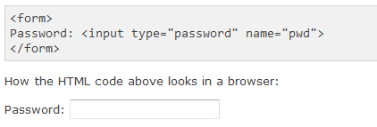
Password Field
<input type="password"> defines a password field:

Slide 18
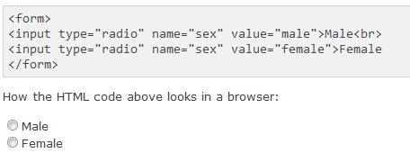
Radio Buttons
<input type="radio"> defines a radio button. Radio buttons let a user select ONLY ONE of a limited number of choices:

Slide 19
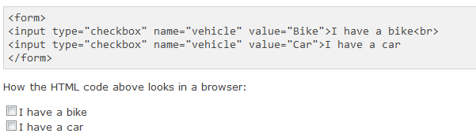
Checkboxes
<input type="checkbox"> defines a checkbox. Checkboxes let a user select ZERO or MORE options of a limited number of choices.

Slide 20
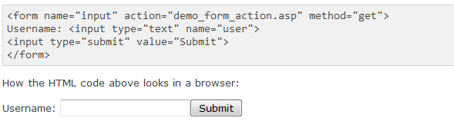
Submit Button
<input type="submit"> defines a submit button.
A submit button is used to send form data to a server. The data is sent to the page specified in the form's action attribute. The file defined in the action attribute usually does something with the received input:

Slide 21
Explain
If you type some characters in the text field above, and click the "Submit" button, the browser will send your input to a page called "demo_form_action.asp". The page will show you the received input.

Slide 22
Fieldset around form-data:
How to create a border around elements in a form.
The <fieldset> tag is used to group related elements in a form.
The <fieldset> tag draws a box around the related elements.
The <legend> tag defines a caption for the <fieldset> element.

Slide 23
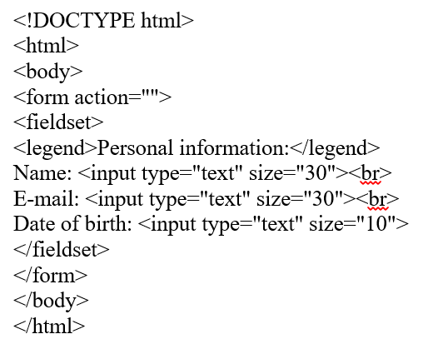

Slide 24
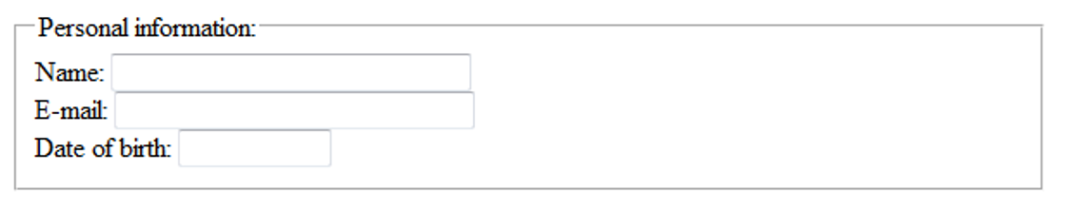

Slide 25
Label Tag
The <label> tag defines a label for an <input> element.
The <label> element does not render as anything special for the user. However, it provides a usability improvement for mouse users, because if the user clicks on the text within the <label> element, it toggles the control.
The for attribute of the <label> tag should be equal to the id attribute of the related element to bind them together.

Slide 26
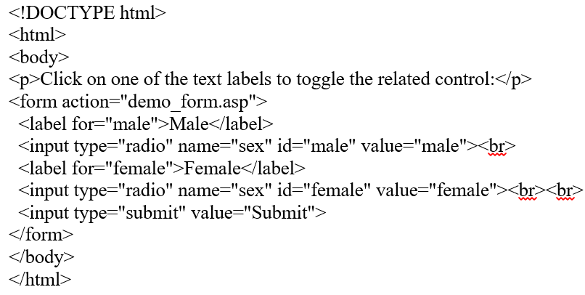

Slide 27
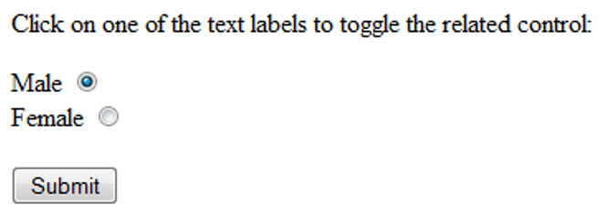

Slide 28
Textarea Tag
The <textarea> tag defines a multi-line text input control.
A text area can hold an unlimited number of characters, and the text renders in a fixed-width font (usually Courier).
The size of a text area can be specified by the cols and rows attributes, or even better; through CSS' height and width properties.

Slide 29
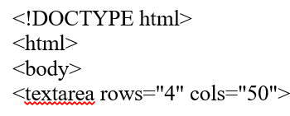
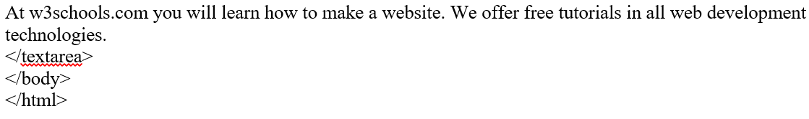

Slide 30
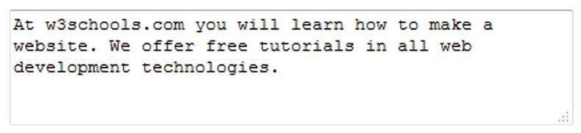

Slide 31
Select Tag
The <select> element is used to create a drop-down list.
The <option> tags inside the <select> element define the available options in the list.
Note: The <select> element is a form control and can be used in a form to collect user input.

Slide 32
Option Tag
The <option> tag defines an option in a select list.
Note: The <option> tag can be used without any attributes, but you usually need the value attribute, which indicates what is sent to the server.

Slide 33
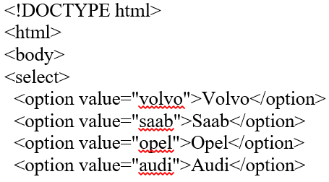


Slide 34
